Slide 1
MA3077 (DLI) Operational Research Lecture 22: Priority-discipline queueing models
Dr Marco Fasondini

Slide 2
Recapitulation and lecture outline
Recap: so far we have learnt a few variations on the M/M/s models. More precisely, we looked at the:
M/M/s/K model
M/M/s model with finite calling populations.
In this lecture: The M/M/s model with priority queue disciplines, following closely Ch. 17.8 of the book by Hillier and Lieberman.

Slide 3
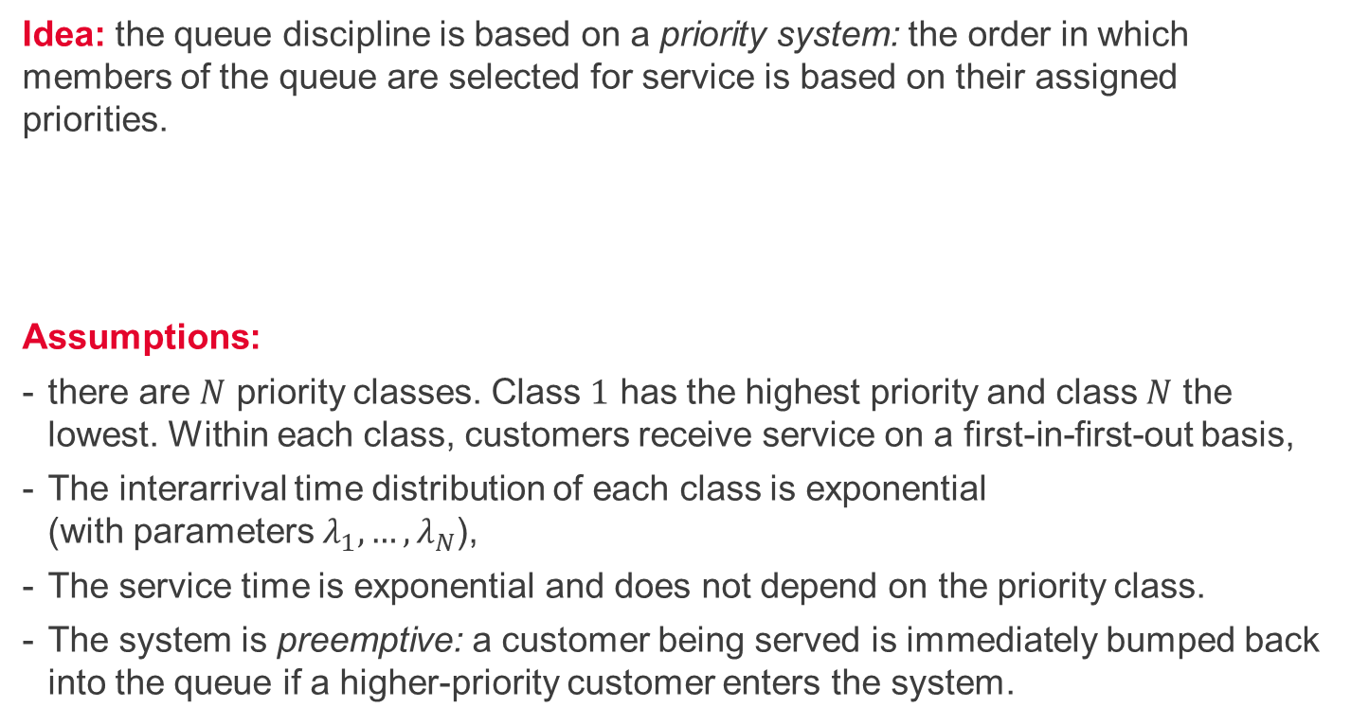
Priority-discipline queueing model
Idea: the queue discipline is based on a priority system: the order in which members of the queue are selected for service is based on their assigned priorities.
Assumptions:
there are $N$ priority classes. Class $1$ has the highest priority and class $N$ the lowest. Within each class, customers receive service on a first-in-first-out basis,
The interarrival time distribution of each class is exponential (with parameters $λ_{1},…,λ_{N}$),
The service time is exponential and does not depend on the priority class.
The system is preemptive: a customer being served is immediately bumped back into the queue if a higher-priority customer enters the system.

Slide 4
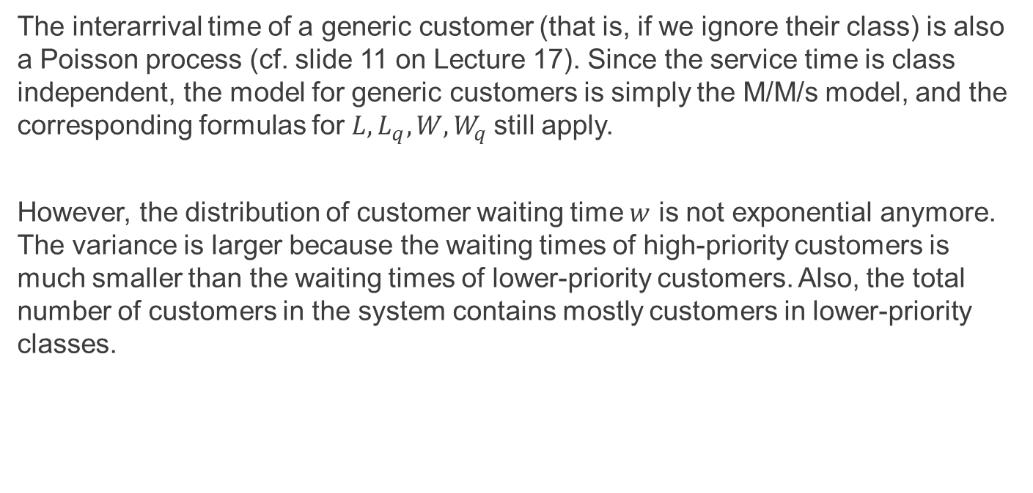
Generic customers (i.e., if we ignore class)
The interarrival time of a generic customer (that is, if we ignore their class) is also a Poisson process (cf. slide 11 on Lecture 17). Since the service time is class independent, the model for generic customers is simply the M/M/s model, and the corresponding formulas for $L, L_{q}, W, W_{q}$still apply.
However, the distribution of customer waiting time $w$ is not exponential anymore. The variance is larger because the waiting times of high-priority customers is much smaller than the waiting times of lower-priority customers. Also, the total number of customers in the system contains mostly customers in lower-priority classes.

Slide 5
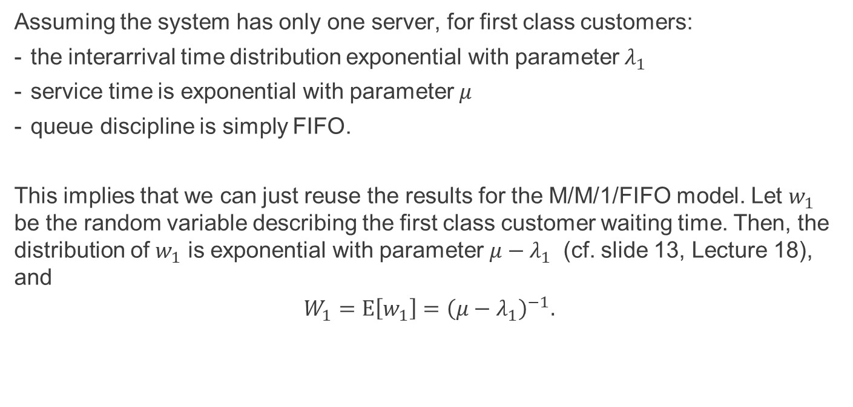
Waiting time distribution with $s=1$ – 1st class
Assuming the system has only one server, for first class customers:
the interarrival time distribution exponential with parameter $λ_{1}$
service time is exponential with parameter $μ$
queue discipline is simply FIFO.
This implies that we can just reuse the results for the M/M/1/FIFO model. Let $w_{1}$ be the random variable describing the first class customer waiting time. Then, the distribution of $w_{1}$ is exponential with parameter $μ−λ_{1}$ (cf. slide 13, Lecture 18), and
$$W_{1}=E\left[w_{1}\right]={\left(μ−λ_{1}\right)}^{−1}.$$

Slide 6
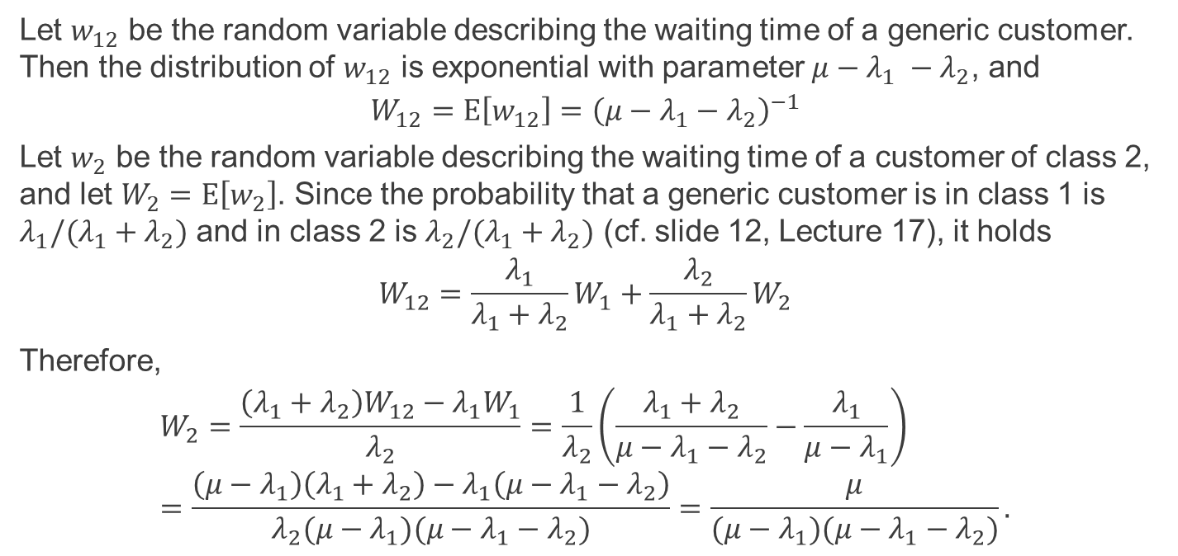
Waiting time distribution with $s=1$ – 2nd class
Let $w_{12}$ be the random variable describing the waiting time of a generic customer. Then the distribution of $w_{12}$ is exponential with parameter $μ−λ_{1} −λ_{2}$, and
$$W_{12}=E\left[w_{12}\right]={\left(μ−λ_{1}−λ_{2}\right)}^{−1}$$
Let $w_{2}$ be the random variable describing the waiting time of a customer of class 2, and let $W_{2}=E\left[w_{2}\right]$. Since the probability that a generic customer is in class 1 is $λ_{1}/(λ_{1}+λ_{2})$ and in class 2 is $λ_{2}/(λ_{1}+λ_{2})$ (cf. slide 12, Lecture 17), it holds
$$W_{12}=\frac{λ_{1}}{λ_{1}+λ_{2}}W_{1}+\frac{λ_{2}}{λ_{1}+λ_{2}}W_{2}$$
Therefore,
$$W_{2}=\frac{\left(λ_{1}+λ_{2}\right)W_{12}−λ_{1}W_{1}}{λ_{2}}=\frac{1}{λ_{2}}\left(\frac{λ_{1}+λ_{2}}{μ−λ_{1}−λ_{2}}−\frac{λ_{1}}{μ−λ_{1}}\right) \\ =\frac{\left(μ−λ_{1}\right)\left(λ_{1}+λ_{2}\right)−λ_{1}\left(μ−λ_{1}−λ_{2}\right)}{λ_{2}(μ−λ_{1})(μ−λ_{1}−λ_{2})}=\frac{μ}{(μ−λ_{1})(μ−λ_{1}−λ_{2})}.$$

Slide 7
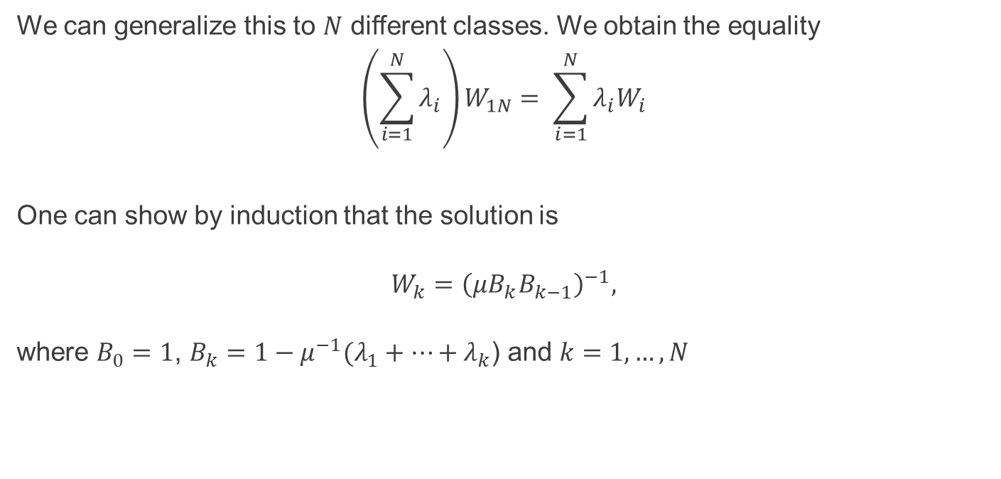
Waiting time formula in preemptive model
We can generalize this to $N$ different classes. We obtain the equality
$$\left(\sum_{i=1}^{N}{λ_{i}}\right)W_{1N}= \sum_{i=1}^{N}{λ_{i}W_{i}}$$
One can show by induction that the solution is
$$W_{k}={\left(μB_{k}B_{k−1}\right)}^{−1},$$ where $B_{0}=1$, $B_{k}=1−μ^{−1}({λ_{1}+…+λ}_{k}$) and $k=1, …, N$

Slide 8

Summary and self-study
Summary: today we have had a look at queueing systems with preemptive priority queue discipline.
Self-study: Consider an M/M/1 model with (preemptive) priority queueing discipline and two classes with $λ_{1}=0.2$, $λ_{2}=0.6,$ $μ=3$. Compute $W_{2}$.

